Slide 1
CSE211 COMPUTER ORGANIZATION AND DESIGN
Lecture #0

Slide 2
Course details
LTP – 3 1 0 [Three lectures and One Tutorial/week]
Text Book
COMPUTER SYSTEM ARCHITECTURE by MORRIS MANO, Prentice Hall of India, 3rd Edition, (2007)

Slide 3
What’s CSE 211 All About?!
Introduction to computer architecture
• How is data represented?
• What are the pieces of a computer?
• How do computers work?
Programming
• How do I "talk" directly to the machine?
• How do I program in C?
Computer Systems and Computation
• How do simple HW/SW elements come together to realize complex computations?

Slide 4
Big Picture
Hardware
• Representing data, transistors, gates, digital logic structures, von Neumann machine model
Assembly language
• Instructions, (structured) programming, input/output,
relationship to hardware
C programming
• Syntax, operators, control structures, functions, pointers, recursion, data structures, relationship to assembly language

Slide 5
Why Take CSE211?
Foundational
• Intersects all aspects of computing
How does computing hardware work?
• Where is computing hardware going in the future?
– And learn how to contribute to this future…
• How does this impact system software and applications?
– Essential to understand OS/compilers/PL
– For everyone else, it can help you write better code!
• How are future technologies going to impact computing systems?
Fun!!!
• Who wouldn’t want to know the magician’s tricks?

Slide 6
CSE 211 Implementation
Lectures
Class Test
Exams
Grades

Slide 7
Course Assessment Model
Marks break up*
Attendance 5
CA (Two best out of Three tests) 20
MTE 25
ETE 50
Total 100

Slide 8
The course contents
Basics Of Digital Electronics
Register Transfer and Micro Operations
Basic Computer Organization
Control Unit
Central Processing Unit
Computer Arithmetic
Input-Output Organization
Memory Unit
Introduction to Parallel Processing

Slide 9
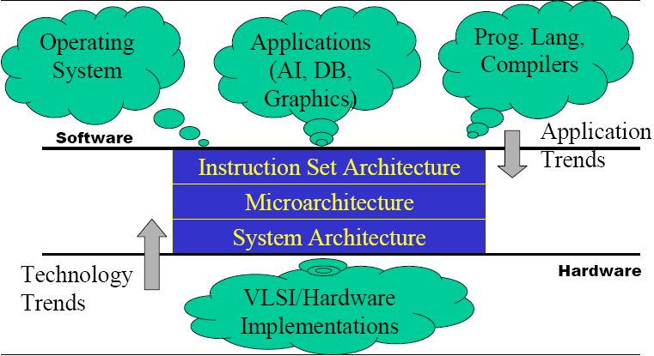
What is Computer Architecture?

Slide 10
Computer Architecture
“Architecture”
The art and science of designing and constructing buildings
A style and method of design and construction
Design, the way components fit together
Computer Architecture
The overall design or structure of a computer system, including the hardware and the software required to run it, especially the internal structure of the microprocessor

Slide 11
Next Class: Logic gates

